Slide 1
March Madness Predictor
Final Presentation
Andrew Bryan

Slide 2
Problem Statement
Problem Statement
Scope
Client
The client aims to predict NCAA Basketball game winners using historical game data in order to enhance basketball strategy and recruitment.
- The scope includes analyzing historical NCAA Basketball data from the 2013/2014 to 2017/2018 seasons.
- The analysis will focus primarily on regular season game data to enhance predictions for tournament matches.
- Despite data availability limitations for seasons beyond 2017/2018, the model aims to provide actionable insights for strategic decisions.
Client: Baylor University
Key Stakeholders:
Baylor's basketball head coach: Scott Drew
Athletic Director: Mack Rhoades

Slide 3
Data Wrangling and Cleaning

Slide 4
Data Deep-dive
Wrangling
Exploring & Learning
The dataset being used was obtained from Google cloud and consisted of game data from the 2013/2014 to 2017/2018 seasons.
The dataset initially consisted of 29,805 instances
Some games had full statistics and others had only the box score
Data was present for games in multiple divisions, not just division 1
Initial investigation revealed 757,543 null values

Slide 5
Data Cleaning
Removing Excess Data
Null Values
Exploring & Learning
Instances from D2, D3, and other division’s games not pertinent to D1 men's basketball, the focus of this project were removed from the dataset.
An extensive array of extraneous columns, such as team logos, possession arrows, and venue addresses, which were irrelevant for this project's goals were also removed from the dataset.
As the project progressed, additional columns were removed from the dataset as the scope was refined and further exploratory analysis was conducted.
For many of the null values, clear substitutes such as 0 or the median of the data were chosen and filled in accordingly.
Upon investigation, it was discovered that certain games contained only box score (final score only), which were deemed inadequate for the model's requirements and consequently removed.
Additionally, irrelevant columns with a substantial number of null values were excluded from the project dataset.

Slide 6
Exploratory Data Analysis

Slide 7
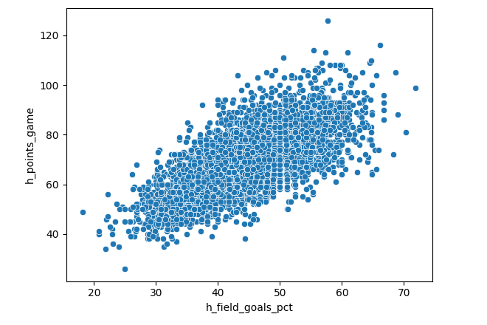
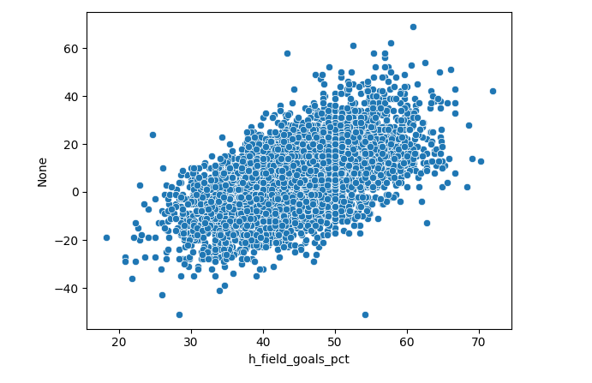
Initial Analysis
The relationships within the game data were as expected. Several key correlations were analyzed and confirmed through scatter plots, which clearly demonstrated that the data behaved as anticipated.

Slide 8
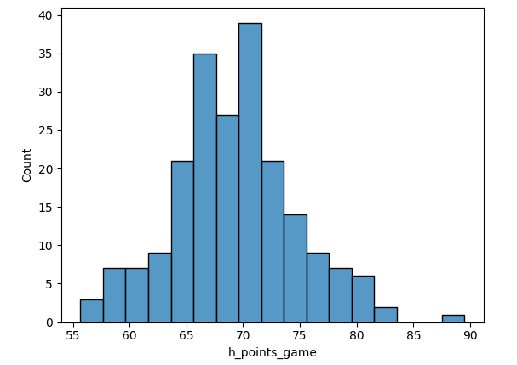
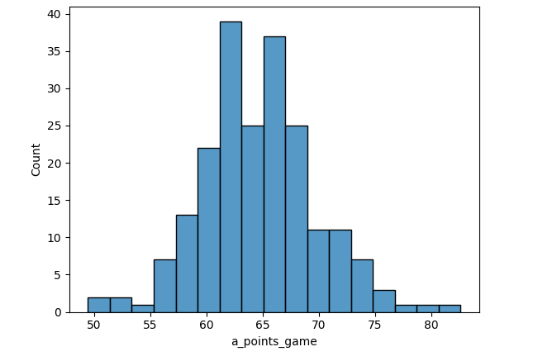
Home Vs Away Data
A critical aspect of the categorical models was examining whether a team's home performance statistically differed from its away performance. This analysis would guide how features were structured in the model, determining whether to use aggregated statistics across all games or to separate them into home and away categories.

Slide 9
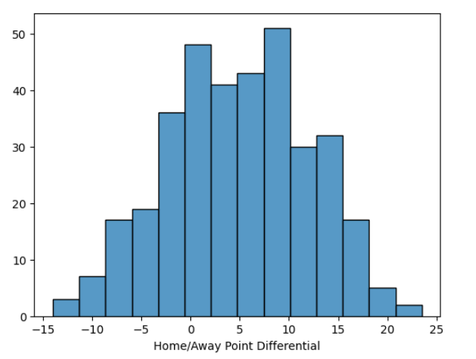
Home Vs Away Data
The analysis revealed an average difference of about 4.99 points between home and away performances. However, a closer examination uncovered considerable variability among individual teams, with some teams scoring up to 20 points more at home than away, while others scored up to 10 points more when playing away. This variability underscores the significant impact of home and away performances on teams, suggesting the need to treat them as distinct features in the predictive model.

Slide 10
Modeling

Slide 11
Data Preparation
Random Forest & Nearest Neighbor
Linear Regression
Effort was dedicated to constructing an effective feature class for the categorical models, beginning with raw game statistics that were transformed into aggregated metrics like mean, median, maximum, and minimum for each team's performance in home and away games. A new table was created to organize this data based on game instances, ensuring comprehensive utilization of pertinent statistics to enhance predictive power. Dummy variables were generated for categorical features, and the target variable, representing point differentials with binary outcomes indicating home or away team wins, formed the basis for predicting game outcomes.
The linear regression model preparation involved careful selection of key features from the original dataset, creation of dummy variables for categorical features like location and team name, and definition of the target variable as statistical fields for each game

Slide 12
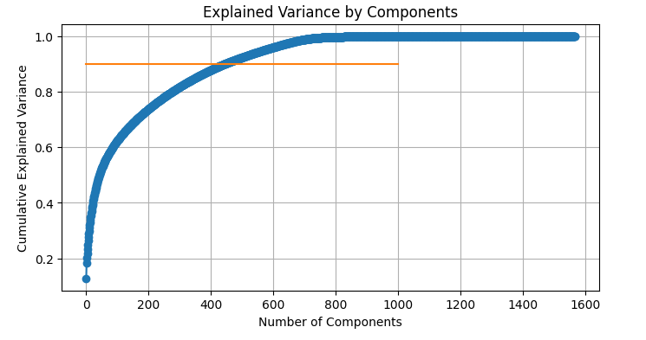
Modeling Execution
Problem Statement
PCA
To address the challenge of a 1600-dimensional feature set from dummy variables and aggregated data in the categorical models, Principal Component Analysis (PCA) was used to reduce dimensionality to 453 components, capturing 90% of the original variance, thus preserving essential data characteristics while enhancing model performance and interpretability.
Random Forest
Nearest Neighbor
Linear Regression
Results from the best model:
Estimator Number: 50
Max Depth: 100
Min Samples per Split: 10
Accuracy: 0.6940298507462687
Precision: 0.6893939393939394
Recall: 1.0
F1 Score: 0.8161434977578476
This model is overfitting to predict the expected winners and not upsets, but for this project, that outcome is not necessarily negative.
Results from the best model:
Number of Neighbors: 13
Accuracy: 0.6865671641791045
Precision: 0.6991869918699187
Recall: 0.945054945054945
F1 Score: 0.8037383177570093
While this model demonstrates slightly improved prediction of upsets, it experiences a marginal decrease in overall accuracy and lower recall, ultimately resulting in a slightly inferior performance.
Unfortunately, the linear regression model did not perform as well as the others. The resulting R-squared value was negative, indicating that this is actually a very poor model.

Slide 13
Result
Random Forest was determined to be the best model for this project.

Slide 14
Future Research

Slide 15
Future Research
1
2
3
Refinement of PCA Strategy
Feature Selection
Refining Linear Regression Approach
Different approaches to PCA could potentially lead to better modeling results
Different approaches to feature selection could lead to better results
The linear regression model proved to be the least successful model. However, with some tweaks to the approach it could end up producing better results as well
Lowering the explained variance threshold
Testing various explained variance limits for PCA
Removing PCA entirely and using the features in the original format
Discarding less impactful features could focus more predictive elements
Implementing Correlation-Based Feature Selection
Categorical Modeling with Recent Trends
Reducing the number of target variables
Replacing all target variables with just the difference in score
Attempting PCA on the linear data as well

